Slide 1

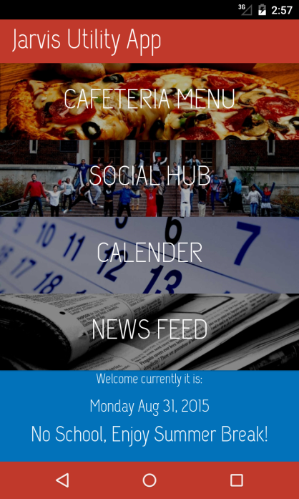
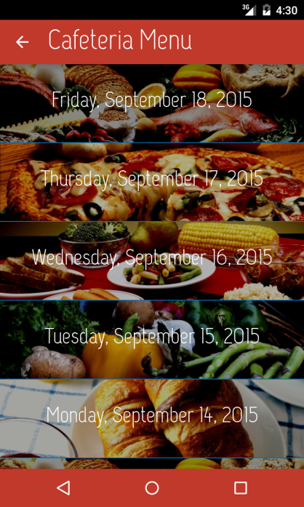
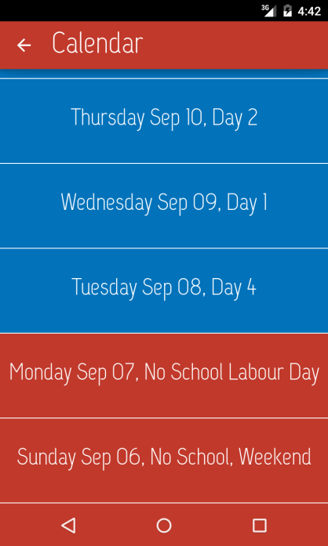
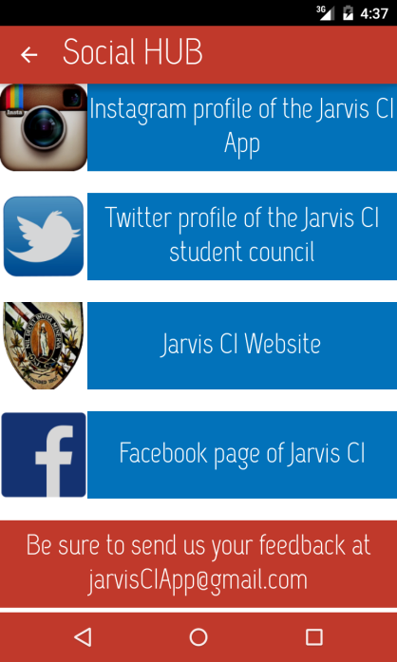
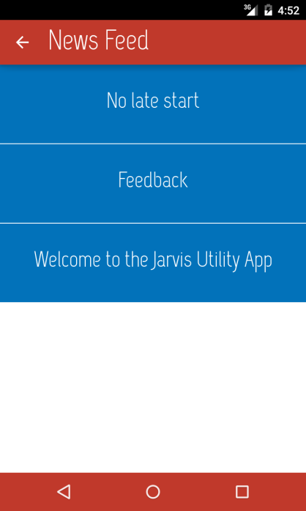





Jarvis Utility App

Slide 2
Jarvis Utility App
Created by the Jarvis App Team
Mahan Pandey
Kazim Hussain
Zoairiah Khan
Lead developer

Slide 3
Functions
Jarvis Utility App lets you –
Plan your meal
Stay connected
Check the periods and schedule day of any date
And, be updated with Jarvis news

Slide 4
Downloading on Android

